Slide 1


Lab 5
Logistic (regression) classifier
With PyTorch 0.2.0_2
Sung Kim <hunkim+ml@gmail.com>
Code: https://github.com/hunkim/DeepLearningZeroToAll/

Slide 2
Lab 5-1
Logistic regression
With PyTorch 0.2.0_2
Sung Kim <hunkim+ml@gmail.com>
Code: https://github.com/hunkim/DeepLearningZeroToAll/

Slide 3
https://github.com/hunkim/DeepLearningZeroToAll/tree/master/pytorch
https://github.com/hunkim/DeepLearningZeroToAll/blob/master/pytorch/lab-05-1-logistic_regression.py

Slide 4


Logistic Regression
Notes:
H(X) = \frac{1}{1 + e^{-W^{T}X}} \\
cost(W)=-\frac{1}{m}\sum {\color{blue}y} log(H(x)) + {\color{blue}(1-y)}(log(1-H(x)) \\
W = W - \alpha\frac{\partial}{\partial W}cost(W)

Slide 5
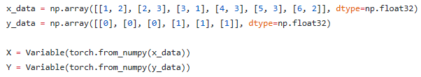
Training Data
https://github.com/hunkim/DeepLearningZeroToAll/blob/master/pytorch/lab-05-1-logistic_regression.py

Slide 6
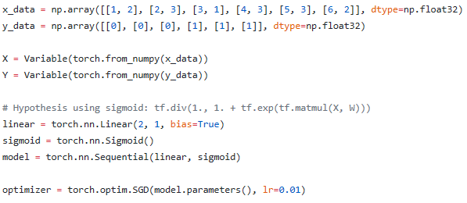
https://github.com/hunkim/DeepLearningZeroToAll/blob/master/pytorch/lab-05-1-logistic_regression.py

Slide 7
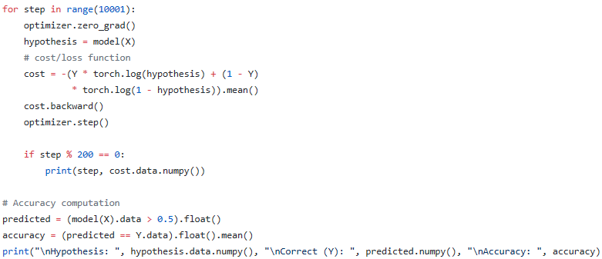
Train the model
https://github.com/hunkim/DeepLearningZeroToAll/blob/master/pytorch/lab-05-1-logistic_regression.py

Slide 8
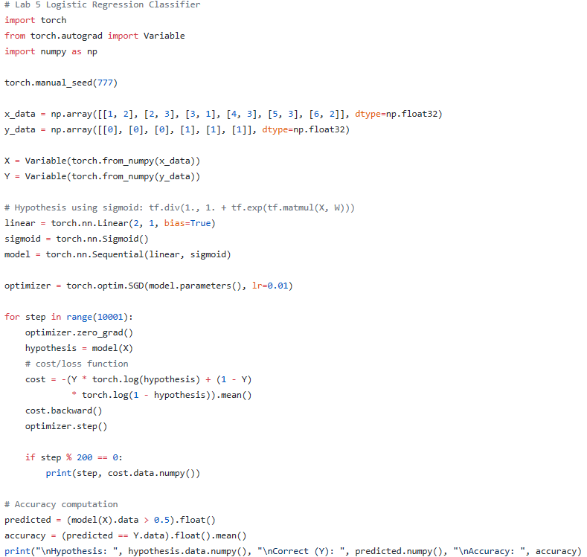
https://github.com/hunkim/DeepLearningZeroToAll/blob/master/pytorch/lab-05-1-logistic_regression.py

Slide 9
Lab 5-2
Logistic regression - diabetes
With PyTorch 0.2.0_2
Sung Kim <hunkim+ml@gmail.com>
Code: https://github.com/hunkim/DeepLearningZeroToAll/

Slide 10
https://github.com/hunkim/DeepLearningZeroToAll/tree/master/pytorch
https://github.com/hunkim/DeepLearningZeroToAll/blob/master/pytorch/lab-05-2-logistic_regression_diabetes.py

Slide 11
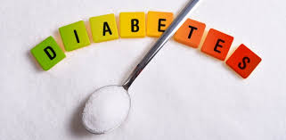
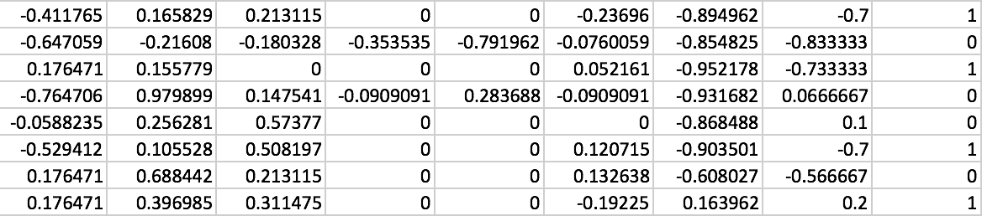

Classifying diabetes
https://github.com/hunkim/DeepLearningZeroToAll/blob/master/pytorch/lab-05-2-logistic_regression_diabetes.py

Slide 12
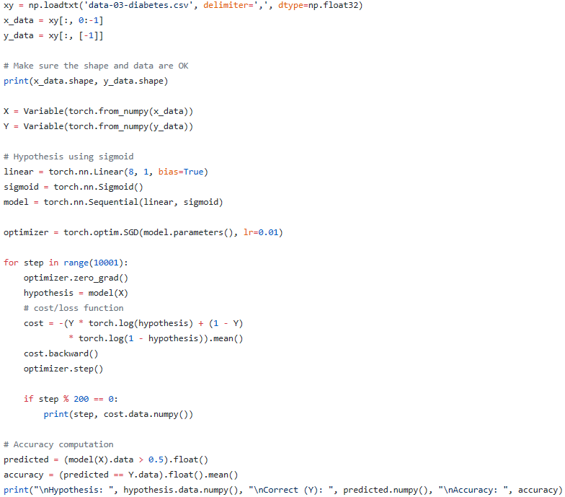
https://github.com/hunkim/DeepLearningZeroToAll/blob/master/pytorch/lab-05-2-logistic_regression_diabetes.py

Slide 13
Exercise
Try other classification data from Kaggle
https://www.kaggle.com

Slide 14
Lab 6
Softmax classifier
With PyTorch 0.2.0_2
Sung Kim <hunkim+ml@gmail.com>

